Slide 1
Erk2 signaling in the Hippocampus
By Chad Ryan

Slide 2
Starring: Erk2 kinase
Supporting Role: Agonists (Clozapine, etc…)
Stages: Forced Swim Test and Elevated Plus Maze

Slide 3
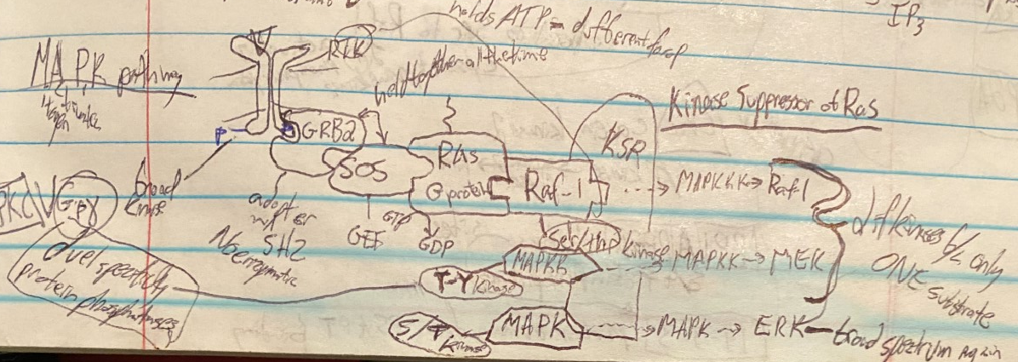
General MAPK pathway (Beginning)

Slide 4
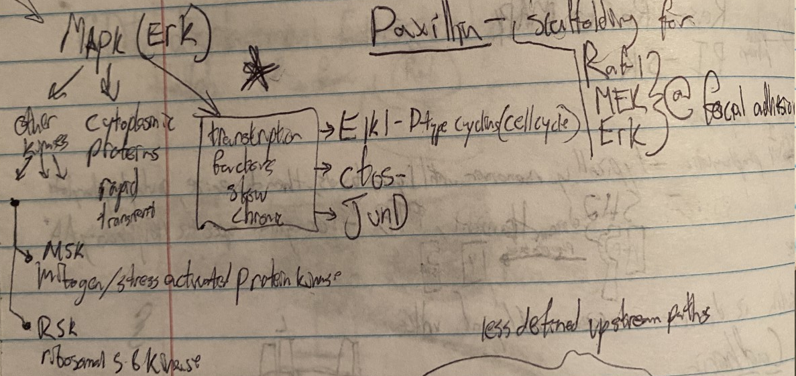
Continued..

Slide 5
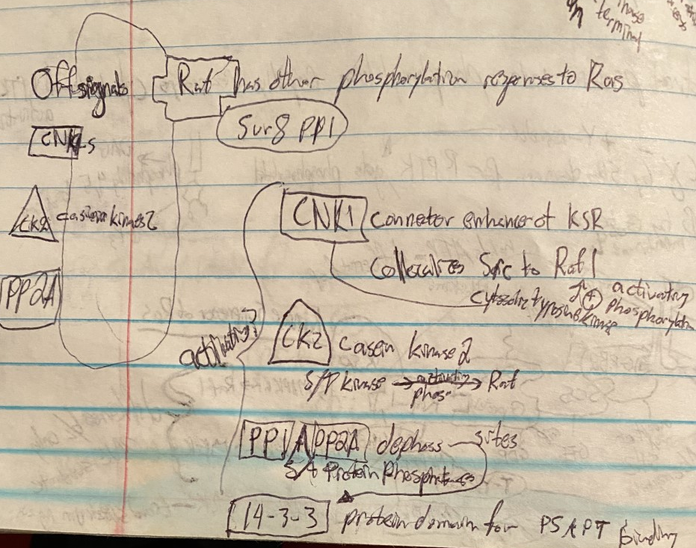
Off Signals

Slide 6
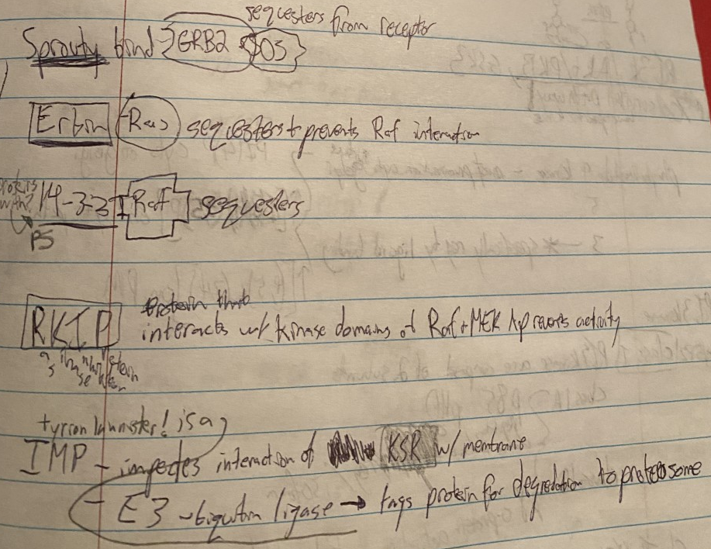
More Repressors

Slide 7
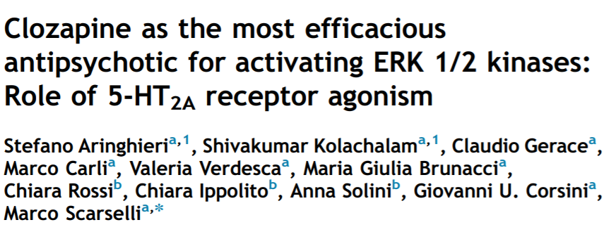
Onto first background

Slide 8
Figure 1 First vs Second Gen Antipsychotics

Slide 9
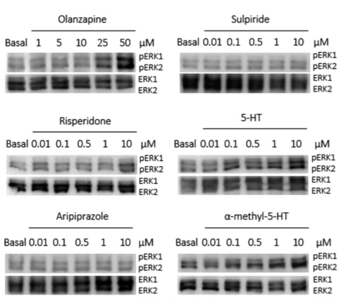
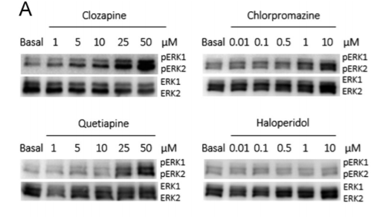
Figure 2a

Slide 10
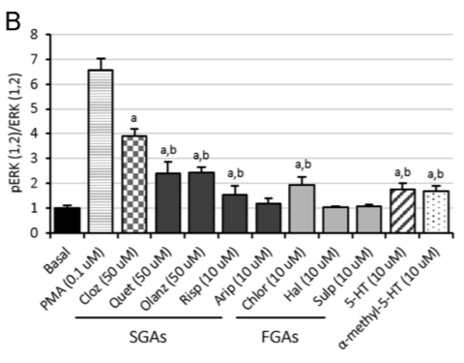
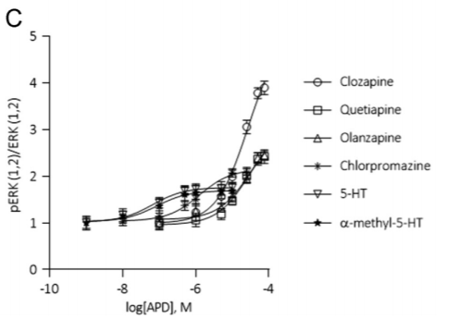
Figure 2 B,C

Slide 11
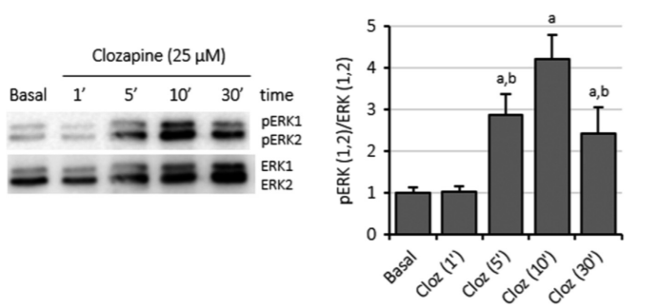
Figre 3 Time course for Clozapine

Slide 12
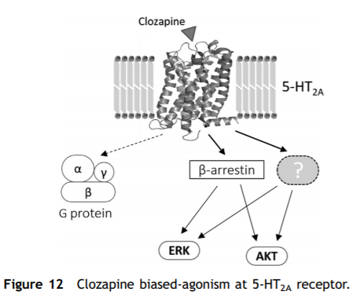
Biased Agonism of 5-HT2A receptor hypothesis

Slide 13
Conclusions
In vitro work of HeLa cells show clozapine is most efficacious ERK1/2 antipsychotic
The mechanism of clozapine is thought to be a biased agonism of indirect intracellular signaling through the 5HT 2a receptor

Slide 14
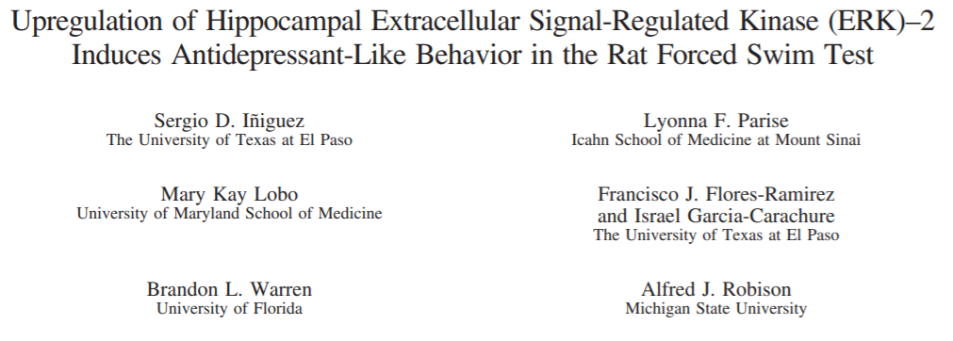
Second Paper (Middle)

Slide 15
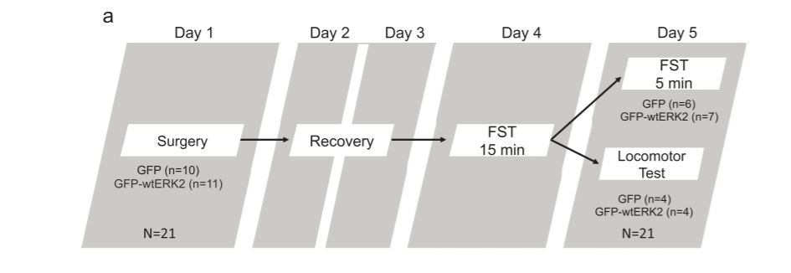
Experimental Design

Slide 16
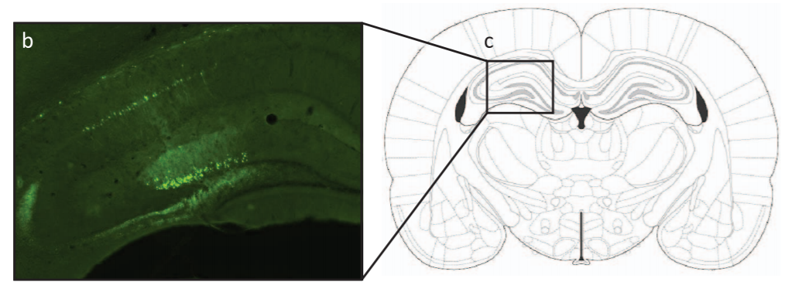
Site of Herpes Simplex Viral Injection

Slide 17
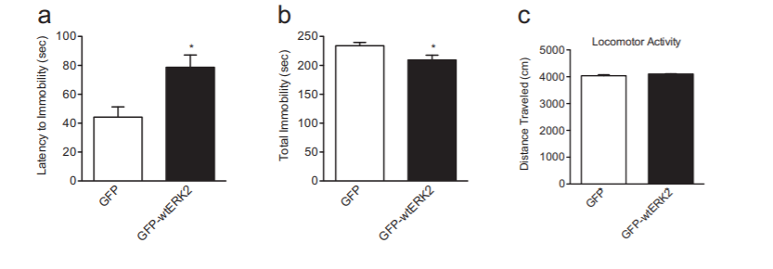
Figure 2

Slide 18
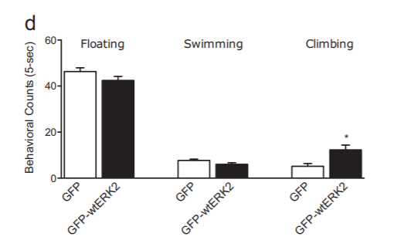
Figure 2 continued

Slide 19
Conclusions from Background Paper 2
Viral upregulations of ERK2 expression in rat dorsal hippocampus:
-increases latency to immobility, total time immobile, and climbing behaviors w/o change in locomotor activity
-These escape-directed findings are thought to be related to antidepressive behaviors

Slide 20
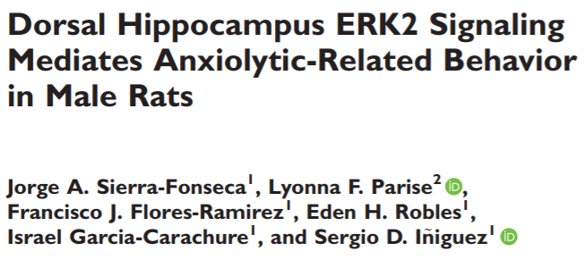
Topic Paper (Climax)

Slide 21
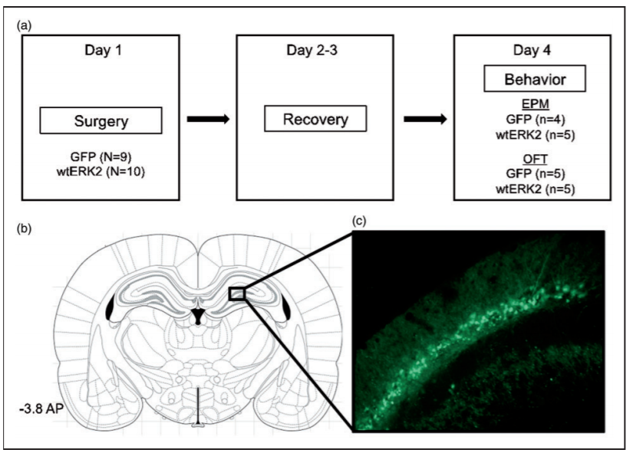
Experimental Setup

Slide 22
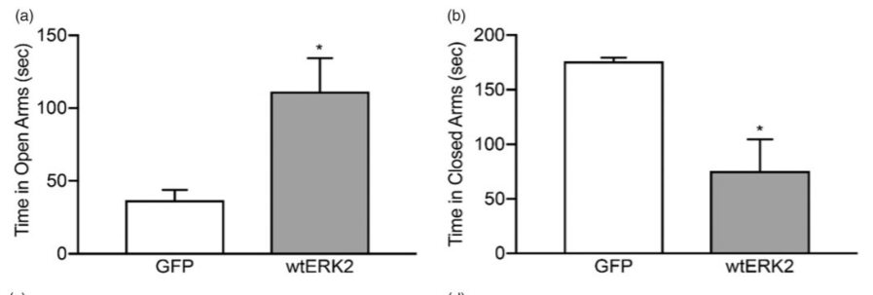
Figure 2

Slide 23
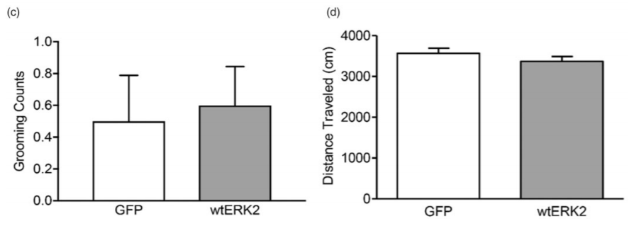
Figure 2 continued

Slide 24
Conclusions
Viral Upregulation of ERK2 in the Dorsal Hippocampus of rats:
Increases time in open arms (and less time in closed arms) of elevated plus maze with no change in locomotor activity or grooming
These findings are attributed to anxiolytic behavior

Slide 25
Summary of ERK2
-ERK2 is a major molecular pathway involved in growth and cell survival. It is highly convergent and highly divergent, making it a molecular hub of cellular trafficking
-Clozapine is the most efficacious antipsychotic for activating ERK1/2
-Viral upregulation of ERK2 in the dorsal hippocampus:
Shows anti-depressive escape related behavior in Forced Swim Test
Shows anxiolytic-like behavior in Elevated Plus Maze

